Slide 1
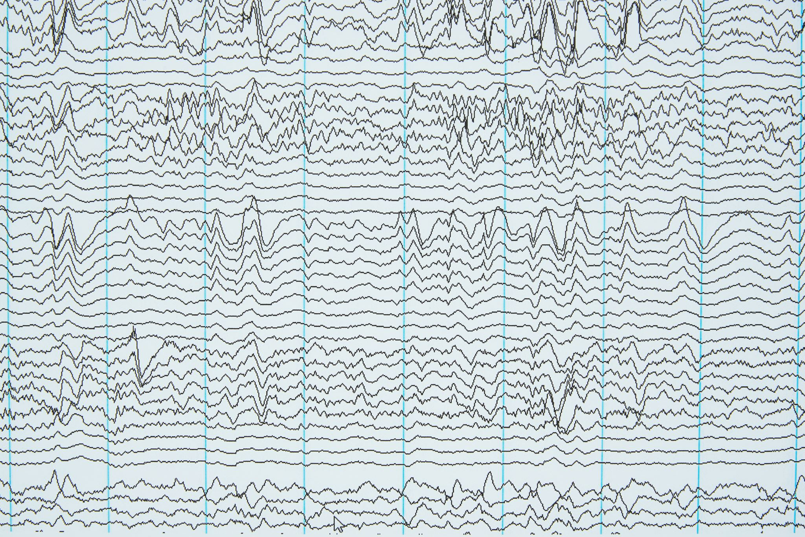
Analyzing Earthquake Trends in Los Angeles (2012-2014)​
Utilizing SCEDC Data for Predictive Analysis and Risk Mitigation
Team 5
Kimberly Cervantes, Jasmine Pesantes, Sze Wa Ng, Chris Fierro, and Alejandro Ortiz

Slide 2
Abstract/Intro
Analyze the frequency and magnitude of earthquakes in Los Angeles (2012-2024)
Source : Kaggle www.kaggle.com/datasets/batuhankalem/los-angeles-earthquake-dataset
Dataset Size: 6.77 MB
Methodologies: Predictive modeling (regression, time series), clustering techniques.
Magnitude categories converted to ML for Consistency
Pattern Analysis, risk assessment, and disaster preparedness

Slide 3
Related Work
Predictive Modeling:
Regression analysis for relation identification
Time series for cyclical trends
Clustering Techniques:
Grouping regions based on seismic characteristics

Slide 4
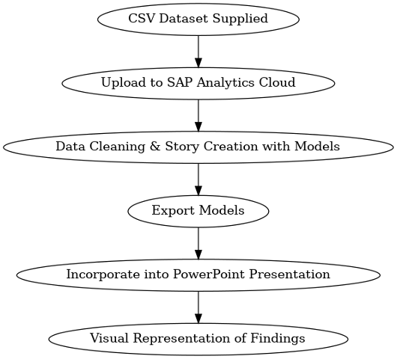
Implementation Flowchart
Process Overview:
Dataset download from Kaggle
Data cleaning and modeling in SAP Analytics Cloud
Export and presentation creation
Visual:
Include a flowchart illustrating the data process.

Slide 5
Data Specifications
Data Source: Kaggle, updated from SCEDC.
Verification: Supported by USGS.
Challenges:
Presence of unknown fault zones (e.g., Puente Hills fault, discovered in 1999).
Recent Event: 4.4 magnitude earthquake in August 2024.
Additional Point: Outline how the dataset's depth and breadth enhance its suitability for predictive modeling based on elapsed time.

Slide 6
Data Cleaning
Uploaded to SAP Analytics Cloud
Aggregation type and measure adjustments for accuracy
Verification using SAP data quality tools
Insights –Discussion on b-value relevance and microquakes

Slide 7
Analysis and Visualization Overview
Visuals Created:
Relationship graphs
GeoMapping visuals
Statistical evaluations

Slide 8
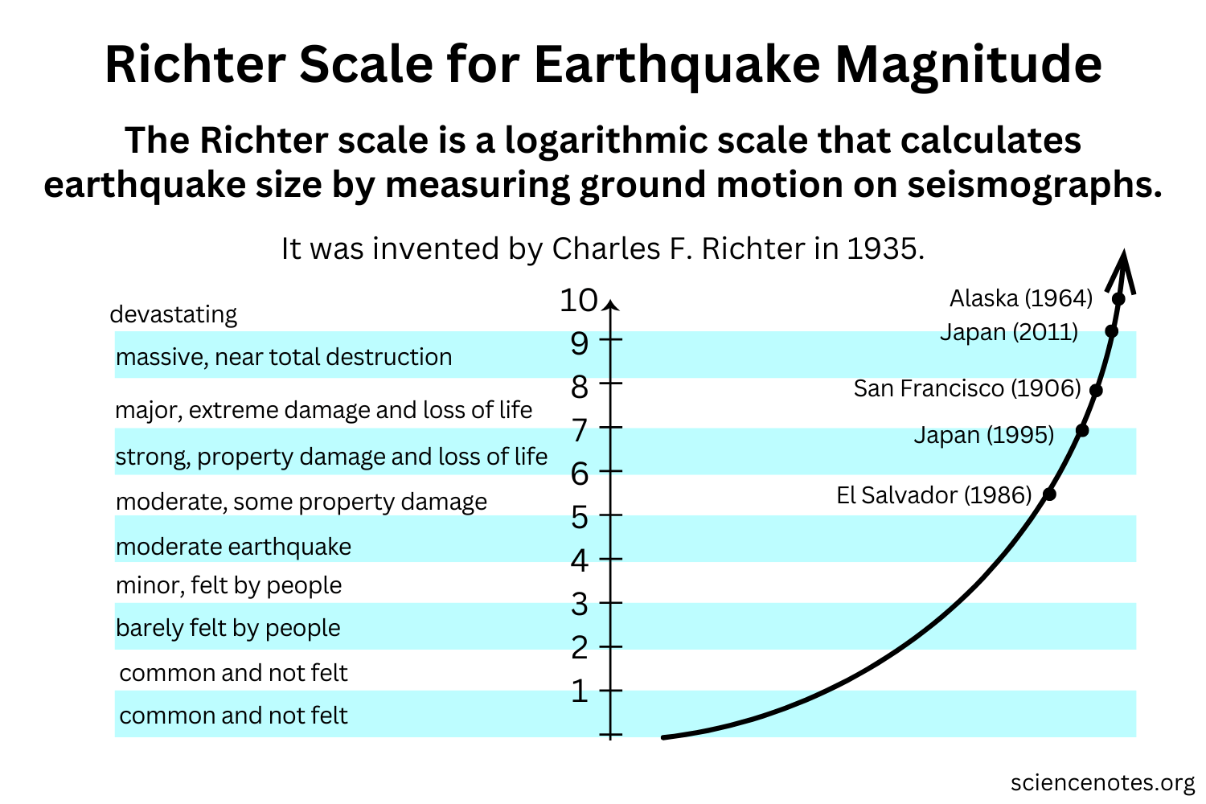
Definitions:
Magnitude:
A measure of the size or strength of an earthquake (amount of energy released at its source).
Measured on a logarithmic scale.
Each level is 10X stronger than the previous value.

Slide 9
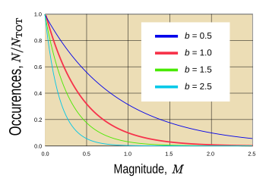
Definitions:
b-value measures the ratio of small to large earthquakes in a region.
High b-value (>1.0) means more small earthquakes, common in volcanic or fractured areas.
Low b-value (<1.0) means more large earthquakes, often in high-stress fault zones.

Slide 10
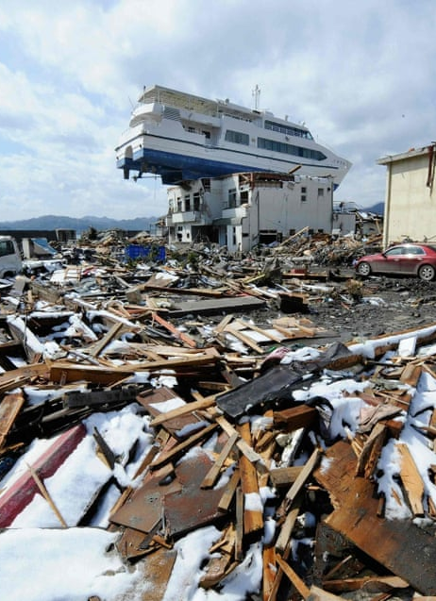
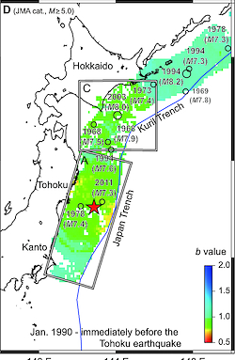
Example:
Tohoku, Japan 2011 (9.0M)
Low b-values (<1.0) along the subduction zone, indicating high stress accumulation.
Comparing to higher b-values (>1.0) of areas experiencing more small earthquakes...less likely to rupture in a massive event.
The low b-values along the Japan Trench suggested a higher probability of a large earthquake, which was confirmed when the catastrophic quake struck.

Slide 11
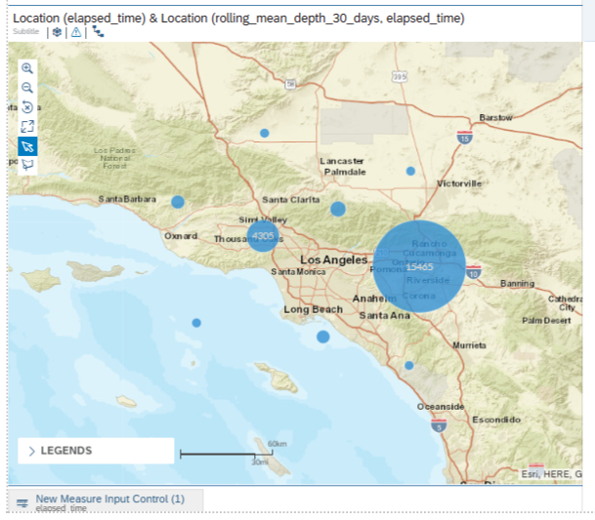
GeoMapping of Recent Earthquakes
Observations: Over 15,000 earthquakes in eastern L.A., 4,000 near Thousand Oaks from our dataset.
Visual: Map highlighting earthquake hotspots.

Slide 12
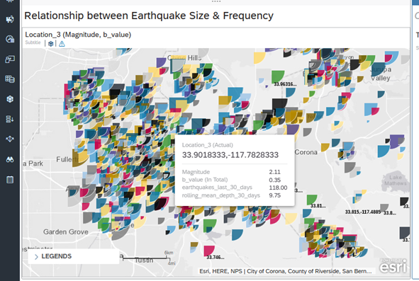
Relationship between Earthquake Size and Frequency
GeoMap analysis: made it is possible to analyze, and locate, high and low b-value regions, revealing tectonic stress buildup.

Slide 13
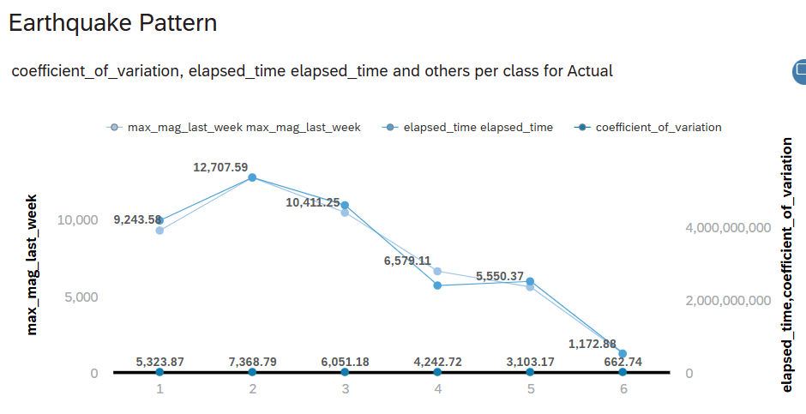
Coefficient of Variation (CV)
Definition: Indicator of predictability and regularity.
Findings:
High CV (>1.0) indicates unpredictability.
Low CV (<1.0) suggests regular patterns.
Visual: CV comparison chart.

Slide 14
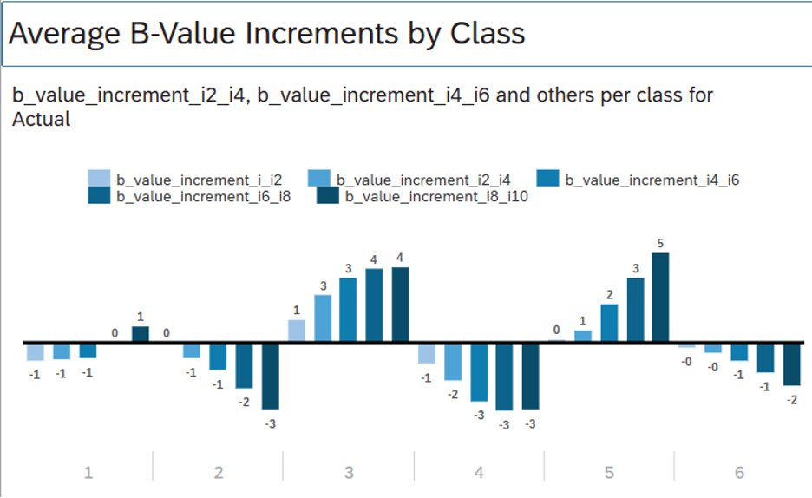
Impact of B-Value on Seismic Hazard
Concept: Correlation between B-value and seismic activity.
Findings:
High B-value: More frequent smaller earthquakes.
Low B-value: Fewer but larger earthquakes.
Visual: Normal distribution graph of B-values.

Slide 15
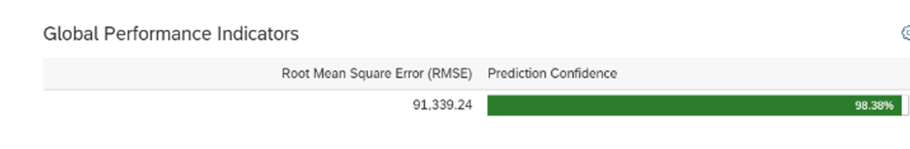
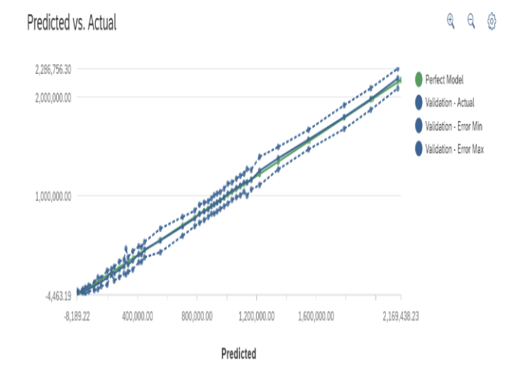
Regression Analysis Results
Key Findings:
High prediction confidence (98.38%).
Identification of seismic activity patterns.
Visuals:
RMSE confidence chart.
Predicted vs. Actual graph.

Slide 16
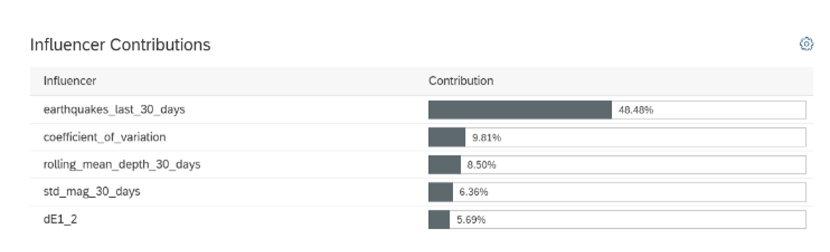
Influencer Contributions
Key Influencers:
Earthquake frequency (48.48%).
Coefficient of variation (9.81%).
Rolling mean depth (8.50%).
Visual: Bar chart of influencer contributions.

Slide 17
Our Conclusion
Summary:
Accurate predictive modeling a confidence rate of 98%.
Key drivers of seismic trends identified.
Modeled based on elapsed time since last earthquake.
Emphasis on the importance of preparedness and risk mitigation.
Future Work: Continuous monitoring and enhancement of predictive models.
Visit github.com/cfier001/Earthquake-data/blob/main/Earthquake%20Trends.pptx for a copy of this presentation

